Slide 1
Robot Programming Languages and Systems
Aryan Ebrahimpour
University of Guilan

Slide 2
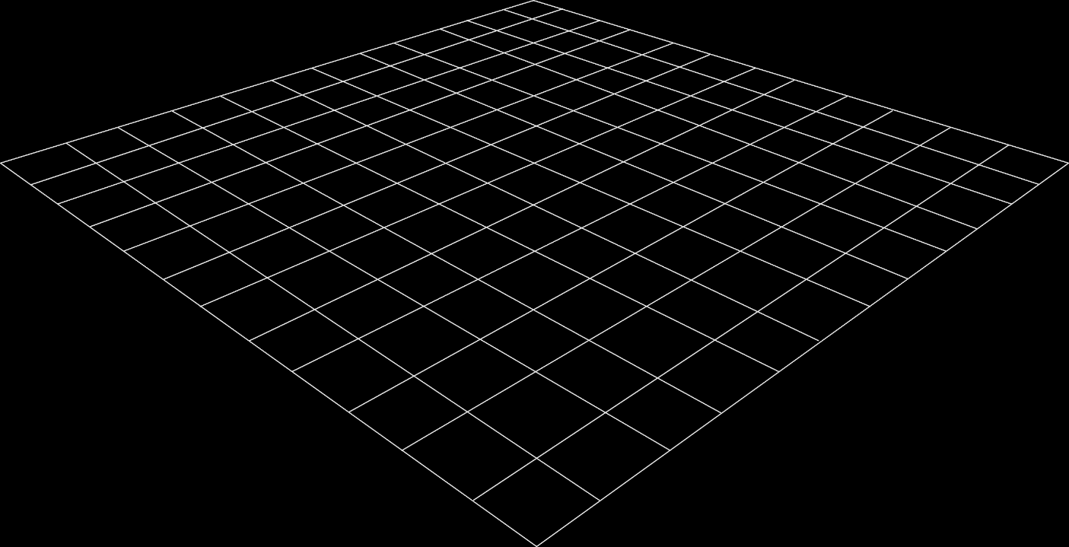
Roster
Introduction
The 3 Levels of Robot Programming
A Sample Application
Requirements of Robots Programming Languages
Problems peculiar to Robots Programming Languages

Slide 3
Introduction

Slide 4
Introduction
Interface between Robot and Human
Workcell: local collection on equipment (manipulators, conveyors, etc.)
In larger scale, workcells might be connected factory-wide
Nature of this chapter constantly changes, books get outdated in this area.

Slide 5
Three Levels of Robot Programming Languages
Teach By Showing
Explicit Robot Programming Languages
Specialized Manipulation Languages
Robot library for an existing programming language
Robot library for a new general-purpose language
Task-level Programming Languages

Slide 6
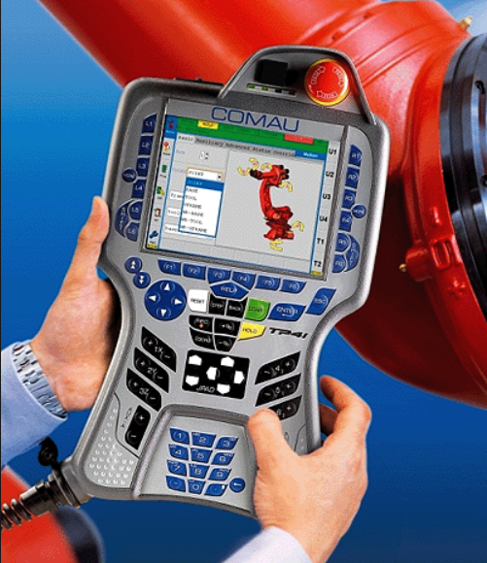
Teach by Showing
Moving robot to desired point and recording the position
By hand or using a Teach Pendant.
In some teach pendants you can enter simple programs including Logic.

Slide 7
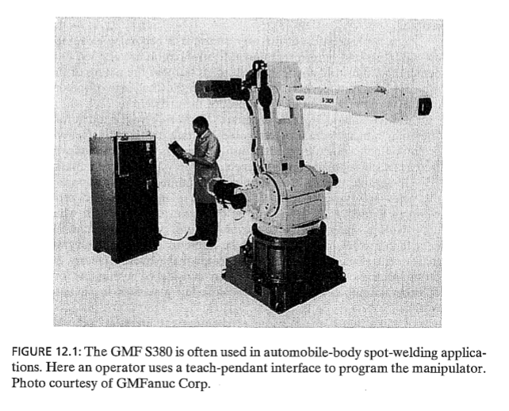
Teach by Showing

Slide 8
Explicit Robot Programming Languages
Inexpensive Powerful Computers
RPLs appeared
Robots with RPLs support came with Teach Pendant also
RPLs has many forms
We split them into 3 categories

Slide 9
ERPL > Specialized manipulation languages.
Completely new languages
Robot-specific areas
Example: VAL Language by Unimation Inc
It was quite weak (no floating point, or character string, no argument pass for subroutines)
New language come with new features called V-II, and then V+
A new language called AL created in Stanford University

Slide 10
ERPL > Specialized manipulation languages.
VAL (Variable Assembly Language)
BASE [<dx>] , [<dy>] , [<dz>] , [<rotation>]

Slide 11

ERPL > Specialized manipulation languages.
V+
.PROGRAM move.parts()
; ABSTRACT: Pick up parts at location pick and put them down at place
parts = 100 ;Number of parts to be processed
height1 = 25.4 ;Approach/depart height at "pick"
height2 = 50.8 ;Approach/depart height at "place"
PARAMETER HAND.TIME = 0.16 ;Set up for slow hand
OPEN ;Make sure the hand is open
RIGHTY ;Make sure configuration is correct
MOVE start ;Move to safe starting location
FOR i = 1 TO parts ;Process the parts
APPRO pick, height1 ;Go toward the pick-up
MOVES pick ;Move to the part
CLOSEI ;Close the hand
DEPARTS height1 ;Back away
APPRO place, height2 ;Go toward the put-down
MOVES place ;Move to the destination
OPENI ;Release the part
DEPARTS height2 ;Back away
Appendix A Pick and Place
350 V+ Language User’s Guide, Rev A
END ;Loop for next part
TYPE "All done. ", /I0, parts, " parts processed"
RETURN ;End of the program
.END
http://www.engr.colostate.edu/me/facil/ramlab/adept/v_lrg.pdf

Slide 12
ERPL > Library for an existing programming language
Creating a RPL based on an existing programming language
JARS, developed by NASA's Jet Propulsion Laboratory, is an example of such a robot programming language based on Pascal

Slide 13





ERPL > Library for a general purpose programming language
Better in large scale
For .NET (F# and C#, etc.):
Machina.NET
AForgeNet
RoboticsFramework
For Python:
Machina Python
RobotPy
Python Robotics
And others as well…

Slide 14
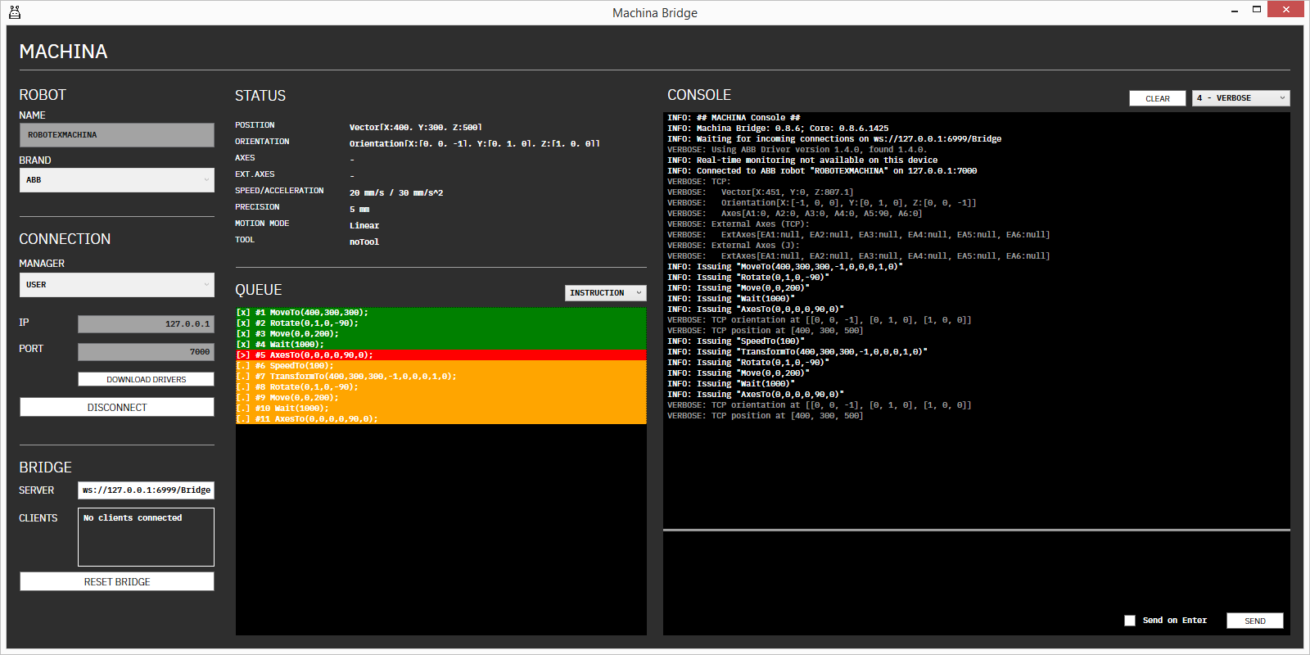
ERPL > Library for a general purpose programming language

Slide 15
Task Level Programming Languages
Command desired goals directly, rather than specifying details
Much more higher Level
Instructions like: “grasp the bolt”
True TLPLs doesn’t exist, but active topic of research

Slide 16
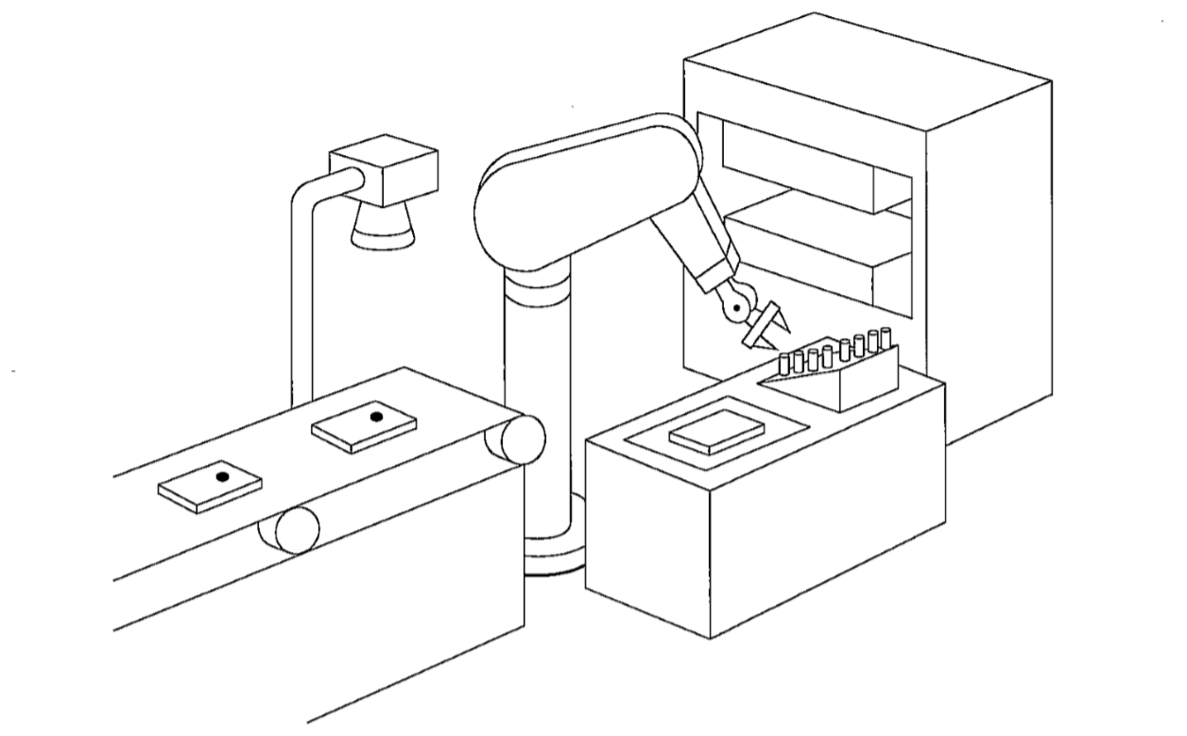
A Sample Application

Slide 17
A Sample Application
Imagine this Workcell:
Press
Camera
PUMA 560
Force-sensing wrist
Feeder
Fixture
Conveyor

Slide 18
A Sample Application
STEP 1
Conveyor is signaled to Start.
Stopped when Vision System detects bracket under camera.
Press
Camera
PUMA 560
Force-sensing wrist
Feeder
Conveyor

Slide 19
A Sample Application
STEP 2
Vision system checks bracket for right position and orientation, also checks if it doesn’t have defects.
Press
Camera
PUMA 560
Force-sensing wrist
Feeder
Conveyor

Slide 20
A Sample Application
STEP 3
Manipulator grasps the bracket with specific force.
Distance of fingers checked .
On failure, robot moves away and vision system restarts.
Press
Camera
PUMA 560
Force-sensing wrist
Feeder
Conveyor

Slide 21
A Sample Application
STEP 4
Bracket is placed on fixture.
Conveyer can be signaled to start in parallel.
Press
Camera
PUMA 560
Force-sensing wrist
Feeder
Conveyor

Slide 22
A Sample Application
STEP 5
Pin is picked from feeder.
Inserted partway in bracket.
Check insertion with force control.
If feeder is empty, signal to wait.
Press
Camera
PUMA 560
Force-sensing wrist
Feeder
Conveyor

Slide 23
A Sample Application
STEP 6
Bracket-Pin assembly is grasped by robot and placed in press.
Press
Camera
PUMA 560
Force-sensing wrist
Feeder
Conveyor

Slide 24
A Sample Application
STEP 7
Press actuates.
Press signals the system and the bracket placed back on the fixture.
Press
Camera
PUMA 560
Force-sensing wrist
Feeder
Conveyor

Slide 25
A Sample Application
STEP 8
Assembly is checked for proper insertion with several checks.
(Manipulator senses reaction force when it presses pin sideways)
Press
Camera
PUMA 560
Force-sensing wrist
Feeder
Conveyor

Slide 26
A Sample Application
STEP 9
If assembly is good → place it in next pallet location
Else → trach can
Press
Camera
PUMA 560
Force-sensing wrist
Feeder
Conveyor

Slide 27
A Sample Application
STEP 10
If step 2 (conveyer) is finished → go to step 3
Press
Camera
PUMA 560
Force-sensing wrist
Feeder
Conveyor

